Slide 1
Green Roots Guyana Proposal
GREENROOTS
Cultivate Sustainable Communities Through Urban Agriculture
Greenroots.org.za | August 2026

Slide 2
Organisation overview
Title: Green Roots Guyana
Tagline: Community-Driven. Sustainability-Focused.
We are:
1. A Community Partner - We work WITH schools, households, and small farmers, not for them
2. An Environmental Steward - We protect soil, biodiversity, and climate resilience
3. A Socioeconomic Catalyst - We link food production to health, youth, and income

Slide 3
Who We Serve &
Who Serves With Us
PRIMARY-Local Residents 25-55
Interested in gardening ,sustainability and community volunteering
Primary volunteer base and workshop participants
Value: skill-building,social connection
Secondary-Local Schools
Seeking educational field trip destinations and support
Life science teachers and parent bodies
Value:CAPS-aligned outdoor learning student engagement
Tertiary-Corporate sponsors& grant bodies
Evaluating social impact for ESG reporting and funding allocation
Value: Measurable outcomes ,brand alignment

Slide 4
Website goals and objectives
GROW OUR PEOPLE
Goal: +40% Volunteer Recruitment
How: Simplified online application + Better event discovery
Why: More hands to transform unutilized spaces
2. GROW OUR FUNDING
Goal: +25% Monthly Donations
How: Secure donation system with one-time + recurring options
Why: Sustain gardens, tools, and training long-term
3. GROW OUR AUTHORITY
Goal: Become a trusted source on Urban Agriculture
How: Downloadable guides, blog articles, impact stories
Why: Educate and empower communities to self-sustain

Slide 5
Proposed website Features
EVENT PLANNER -to inform schools and communities regarding upcoming activities Through events is how the organization transforms spaces Benefit: increases participation and community engagement | DONATE SECTON Sustainabilty is the number one goal for Green Roots Gardens need funding for seeds,tools and training Benefit : Provides a clear way for supporters to contribute and fund our programs | 3 BLOG+RESOURCES Education is core to our mission We need to support people beyond physical events Benefit: Empower schools and households to sustain their gardens long-term Also improves SEO and website traffic

Slide 6
Show Donors Exactly What Their money Does
R50 Compost and mulch for one garden bed for a month | R100 Seeds as well as seedlings for an entire school garden classroom | R200 Seeds for one garden bed and workshop materials for 5 students
R500 Full-day hands-on gardening workshop for 15 residents | R1,000 New vertical garden at an under-resourced schools | R2,000 One month of the youth Green Leadership

Slide 7
Where we are Online
STRENGTHS Domain name Green Roots Guyana.org.za is memorable and brand appropriate Basic contact information and location details are accessible Mobile responsive template | WEAKNESSES Donations are non-functional requiring donors to email or visit in person Poor information hierarchy, the site may prove to difficult to go through and understand what we do and how we help No event calendar

Slide 8
Design and user experience
Headline: “Current Website Design & User Experience”
Left side — Current Design Layout
Green visual identity: The website uses a strong green background to connect directly with the Green Roots environmental theme.
White/light typography: Light text creates contrast against the green background.
Navigation header: The site includes navigation links such as About, Services and Contact, with a “Get in Touch” call-to-action.
Hero section: A dedicated “Gardens Hero” section introduces the organisation and its purpose.
Programme section: “What We Do” introduces the organisation’s activities using a card-grid layout.
Icons: Font Awesome icons are used to visually represent programmes.
Responsive setup: The code includes viewport settings, allowing the website to adapt to different screen sizes.

Slide 9
Development Timeline
The project is planned over a period of nine weeks.
During weeks one and two, the project will focus on discovery and planning.
Weeks three and four will involve gathering content and assets such as photographs, videos, logos and written information.
Development will take place during weeks five to seven.
Week eight will be dedicated to testing and quality assurance.
This is important because the website needs to be tested for functionality, usability, responsiveness and errors before launch.
Finally, during week nine, the website will be launched and handed over to the organisation.

Slide 10
Budget
The estimated development cost for the website is based on 100 hours of development at R250 per hour, which gives a total of R25,000.
Photography is estimated at R1,000 for a half-day shoot.
Graphic design, including social media assets and logo refinement, is estimated at R3,000.
The annual technical infrastructure includes:
R200 for domain renewal
R800 for shared hosting
R1,500 for the Google Maps API
The annual maintenance costs include:
R2,600 for security updates and backups
R10,500 for content updates
R1,500 for the annual performance audit and optimisation
This gives the project a stated first-year investment of R46,100.

Slide 11

Our Vision for 2030
A city where each and every community has access to fresh, locally grown produce and clean water as well as a healthy waterfront-fostering neighbourhoods that serve as a support systems for cultural and economic diversity through shared green spaces
Every primary school Is our target to have a greener future for all, Growing disconnect between youth and naturals ecosystems with limited practical stability
Communities self organise around Urban Agriculture hubs ,fresh produce from garden suplements 50+feeding schemes

Slide 12

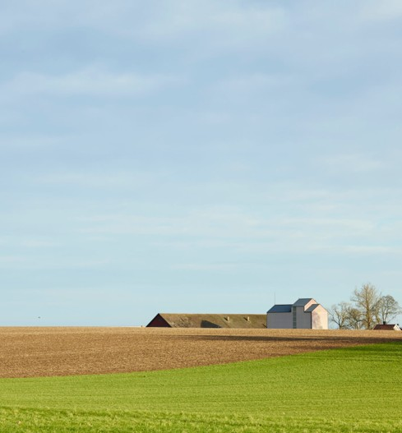
END OF PRESENTATION
THANK YOU.

